Slide 1
Creating Menu

Slide 2
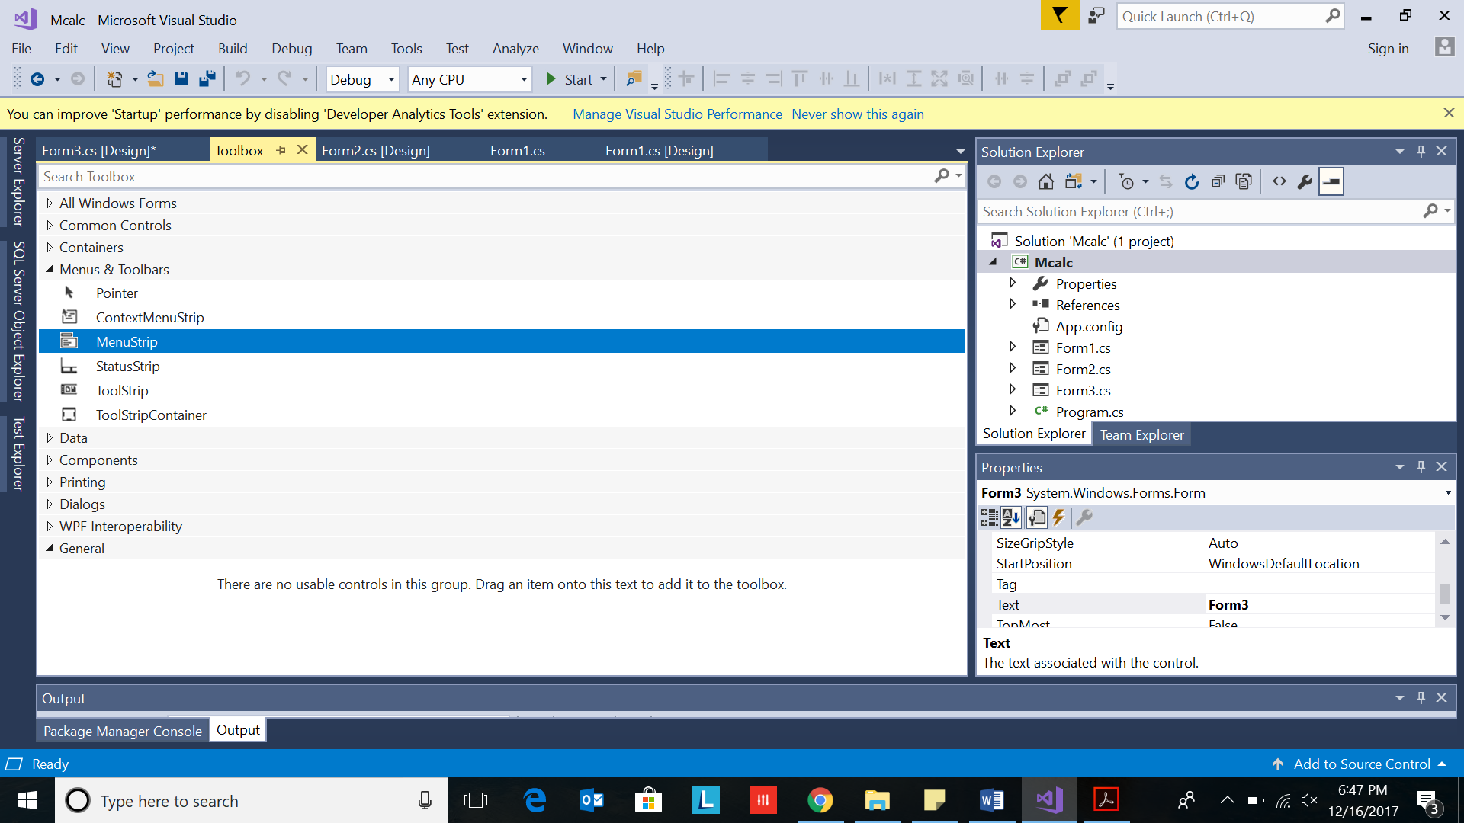
Create Menu
Select Toolbox-> Menus&Toolbars->Menustrip

Slide 3
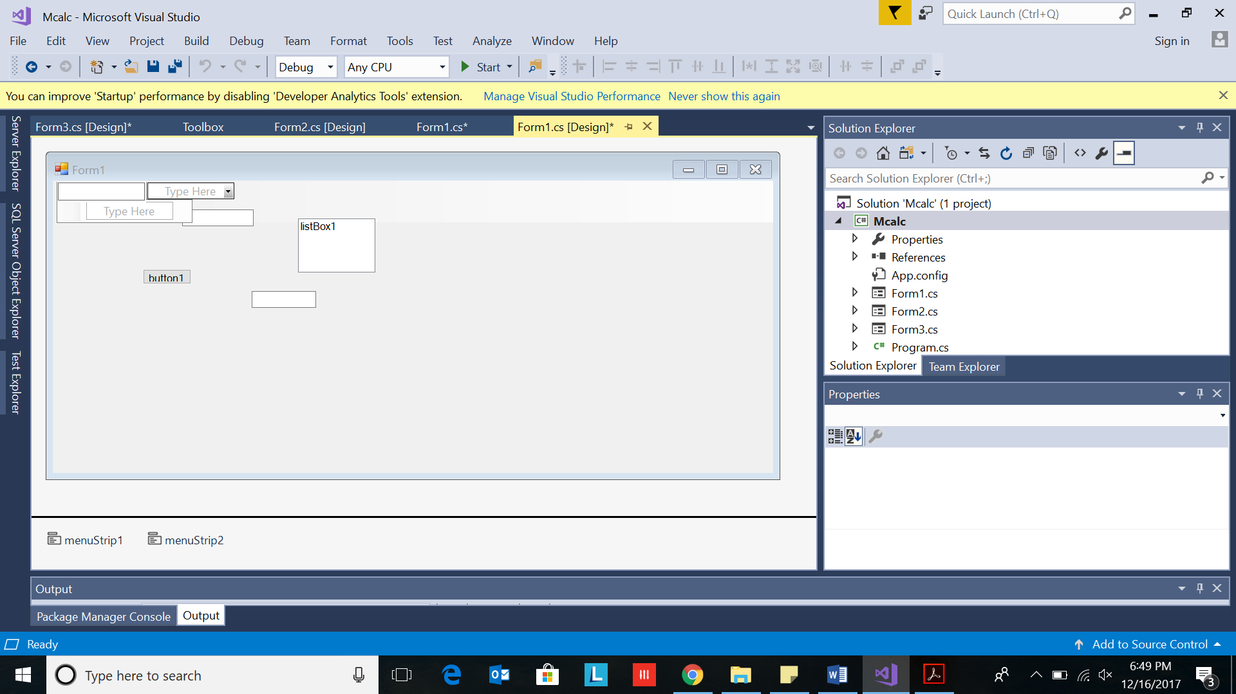
2. Drag and drop on Form1

Slide 4
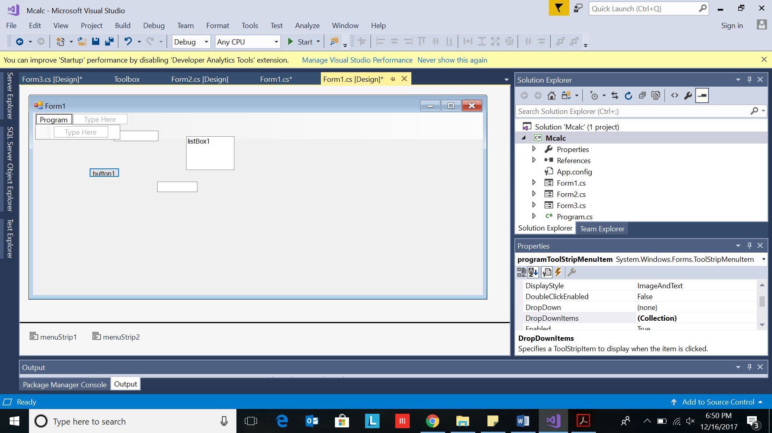
3. Type Programs

Slide 5
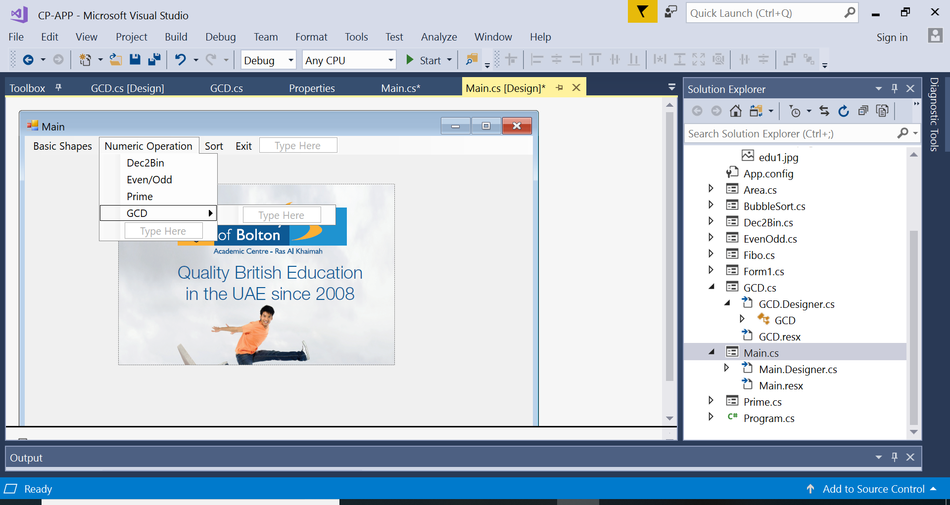
5. Type one below the other: Fibonacci Series EvenOdd GCD

Slide 6
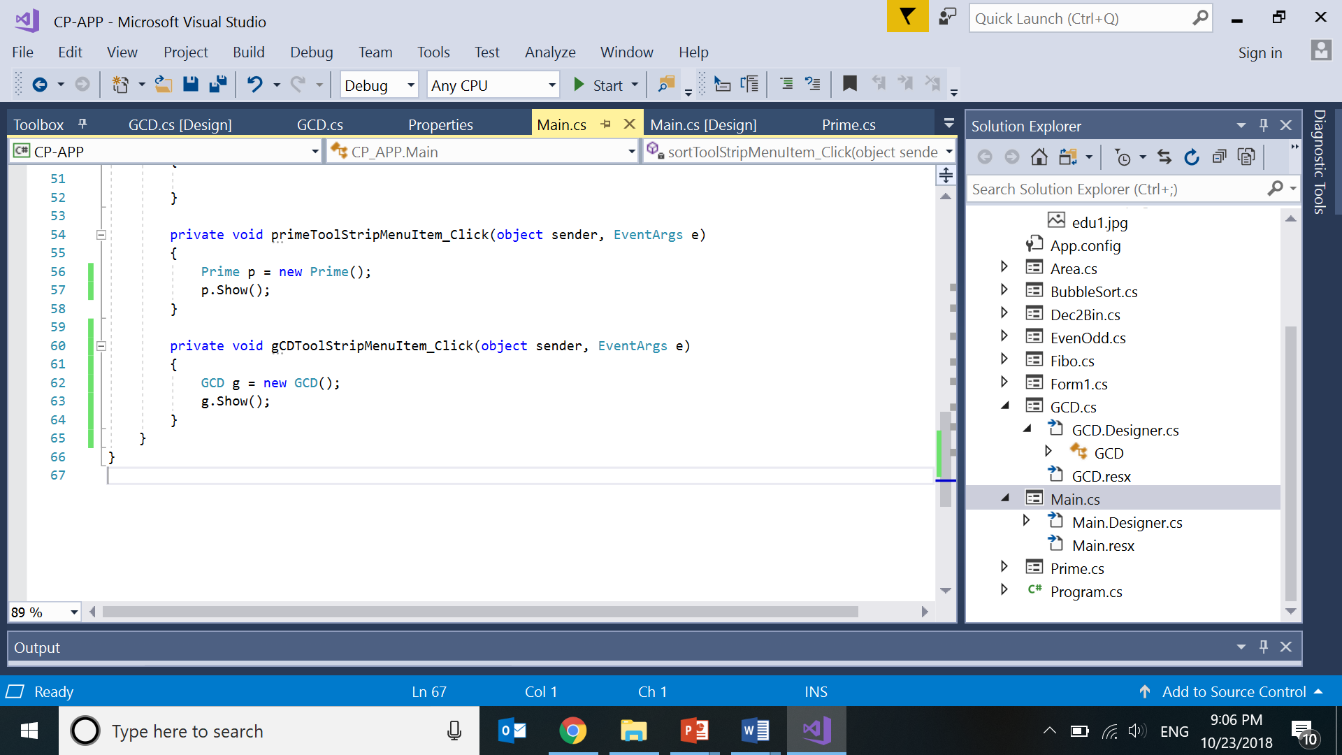
7. Double click on GCD menu

Slide 7

6. Type Exit on side space

